Slide 1
Predictive Maintenance of Industrial Machinery
CAPSTONE PROJECT
Presented By:
1. TANUJA P – Saveetha School of Engineering – Btech IT

Slide 2
OUTLINE
Problem Statement (Should not include solution)
Proposed System/Solution
System Development Approach (Technology Used)
Algorithm & Deployment
Result (Output Image)
Conclusion
Future Scope
References

Slide 3
Problem Statement
Unexpected equipment failures in industrial settings can result in serious production delays, higher operating expenses, and safety risks. Conventional maintenance techniques, like scheduled or reactive maintenance, frequently fall short in identifying possible breakdowns early on. As a result, it becomes imperative to implement a data-driven predictive maintenance strategy that anticipates equipment failures using both historical and real-time sensor data. In order to facilitate proactive maintenance planning, reduce downtime, and maximize resource utilization, the goal is to develop a machine learning model that can precisely forecast when a machine is likely to fail.

Slide 4
Proposed Solution
The proposed system aims to tackle the challenge of minimizing unexpected machine failures in industrial environments by predicting maintenance needs before breakdowns occur. This involves leveraging sensor data, machine logs, and machine learning techniques to anticipate failures. The solution will consist of the following components:
Data Collection:
Gather historical maintenance records, sensor logs (temperature, vibration, pressure, etc.), and machine usage patterns.
Integrate real-time monitoring data from IoT devices or PLCs (Programmable Logic Controllers).
Data Preprocessing:
Clean and preprocess the data to handle missing values, noise, and inconsistencies.
Perform feature engineering to extract failure indicators such as sensor thresholds, operating hours, and load anomalies.
Machine Learning Algorithm:
Implement classification or regression algorithms (e.g., Random Forest, SVM, XGBoost, or LSTM) to predict equipment failure or estimate remaining useful life (RUL).
Consider combining multiple models or using ensemble techniques for improved accuracy and robustness.
Deployment:
Develop a dashboard or application that displays predictive maintenance alerts in real time.
Deploy the system on an industrial-grade cloud platform or edge devices for real-time analytics and low-latency alerts.
Evaluation:
Deploy the system on an industrial-grade cloud platform or edge devices for real-time analytics and low-latency alerts.
Continuously monitor and refine the model based on operational feedback and real-world performance.

Slide 5
System Approach
1. System Requirements
Historical sensor data from industrial machinery (temperature, vibration, pressure, RPM, etc.)
Real-time data streaming capabilities (e.g., IoT sensors)
Data storage system (SQL/NoSQL databases)
Computing platform for model training (local machine or cloud)
Visualization dashboard for maintenance alerts and trends
2. Libraries Required to Build the Model
Python libraries:
pandas – for data loading and manipulation
numpy – for numerical operations
matplotlib & seaborn – for data visualization
scikit-learn – for machine learning algorithms
xgboost or lightgbm – for advanced predictive modeling
tensorflow or pytorch – for deep learning models
joblib or pickle – for model serialization

Slide 6
Algorithm & Deployment
In the Algorithm section, describe the machine learning algorithm chosen for predicting bike counts. Here's an example structure for this section:
Algorithm Selection:
Chosen: Random Forest / XGBoost / LSTM
Reason: Handles nonlinear data, good for classification and time-series prediction
Data Input:
Sensor data: temperature, vibration, pressure
Machine status, usage hours
Maintenance logs, timestamps
Training Process:
Preprocessing: cleaning, encoding, scaling
Train-test split (e.g., 80:20)
Hyperparameter tuning (Grid/Random Search)
Cross-validation used
Prediction Process:
Model predicts machine failure or RUL
Real-time sensor data used
Triggers maintenance alerts before failure

Slide 7
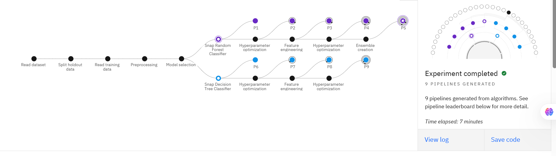
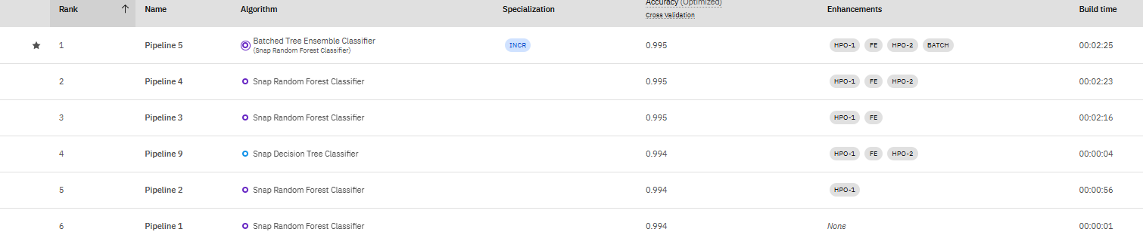
Result

Slide 8
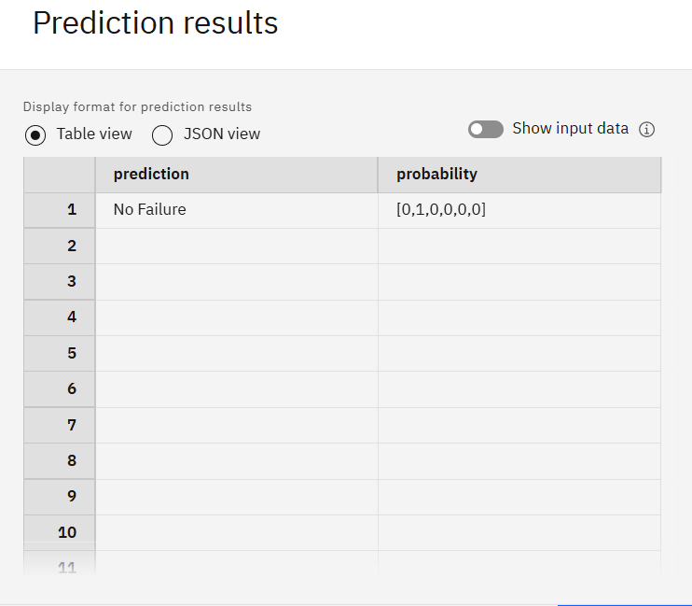
Result

Slide 9
Conclusion
Predictive maintenance shifts maintenance from reactive to proactive and data-driven.
Helps in early detection of equipment failures using AI and sensor data.
Reduces unplanned downtime and overall maintenance costs.
Improves machinery lifespan and operational efficiency.
Enhances safety and reliability in industrial environments.
Plays a vital role in the adoption of Industry 4.0 and smart manufacturing.
Supports sustainable and energy-efficient operations.
Has vast future potential with the integration of AI, IoT, and cloud technologies.
Enables real-time decision-making through continuous condition monitoring.
Facilitates data-driven maintenance scheduling, reducing unnecessary checks.
Increases return on investment (ROI) by optimizing maintenance resources.
Lays the foundation for self-aware and self-healing industrial systems in the future.

Slide 10
Future scope
AI and Deep Learning Advancements Predictive maintenance models will evolve using deep learning techniques to detect complex failure patterns, enabling more accurate failure prediction and remaining useful life (RUL) estimation.
Self-Healing Systems Integration of predictive models with automated repair systems could lead to self-healing machines, where detected faults trigger automatic corrective actions without human intervention.
Cloud-Based Maintenance Platforms Centralized cloud platforms will allow industries to monitor and manage predictive maintenance strategies across multiple factories or locations in real-time.
Augmented Reality (AR) for Maintenance Support AR combined with predictive analytics can guide maintenance personnel during repair tasks by overlaying data-driven insights directly onto machinery.

Slide 11
References
Lee, J., Bagheri, B., & Kao, H.-A. (2015). A Cyber-Physical Systems architecture for Industry 4.0-based manufacturing systems. Manufacturing Letters, 3, 18–23.
Zonta, T., da Costa, C. A., da Rosa Righi, R., de Lima, M. J., da Trindade, E. S., & Li, G. P. (2020). Predictive maintenance in the Industry 4.0: A systematic literature review. Computers & Industrial Engineering, 150, 106889.
Zhou, X., & Yin, Y. (2021). A deep learning method for machinery fault diagnostics based on condition monitoring. Mechanical Systems and Signal Processing, 156, 107619.

Slide 12
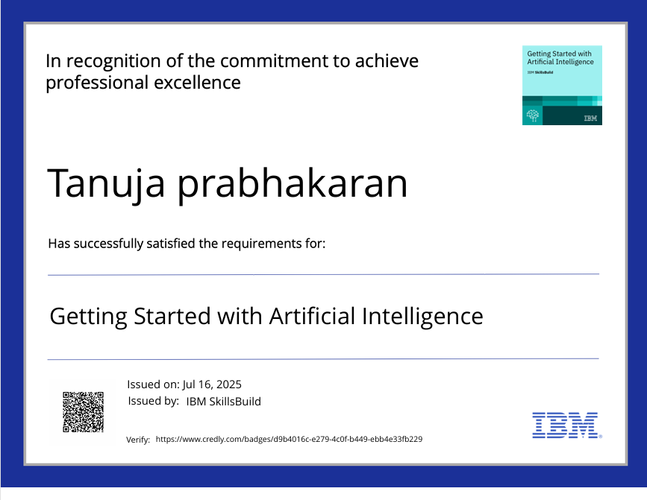
IBM Certifications

Slide 13
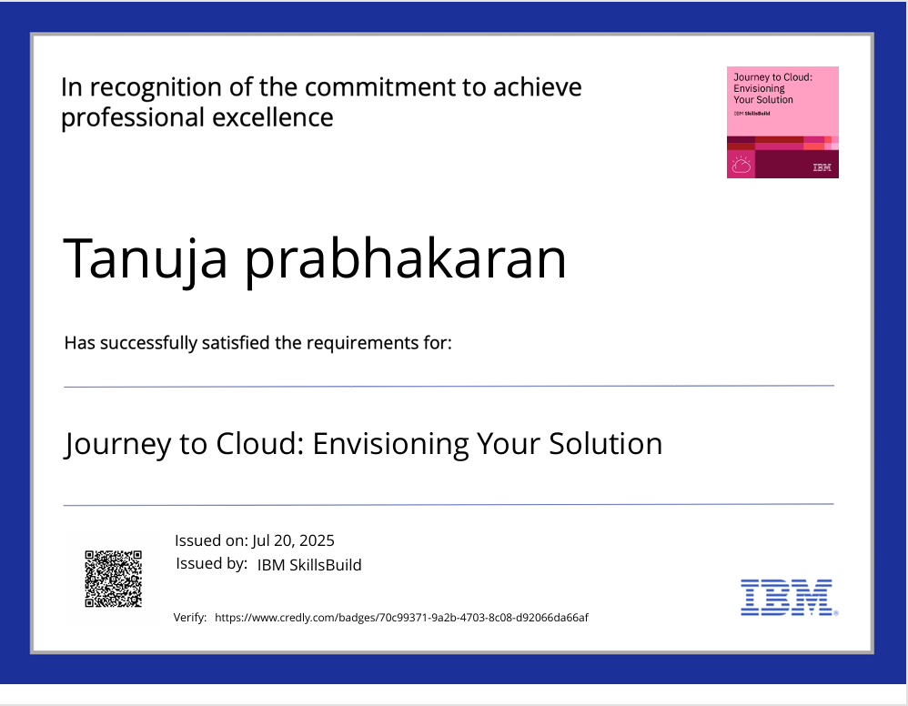
IBM Certifications

Slide 14
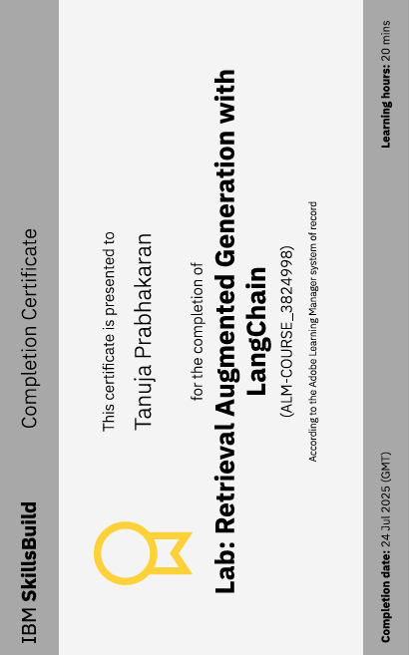
IBM Certifications

Slide 15
THANK YOU

